Slide 1

Milano Cortina 2026
Italy
6 February -22 February

Slide 2
Here are the names of the top key organizations involved in the 2026 Winter Olympics
International Olympic Committee (IOC)
Milano Cortina 2026 Organizing Committee
Italian National Olympic Committee (CONI)
International Paralympic Committee (IPC)
European Olympic Committees (EOC)

Slide 3
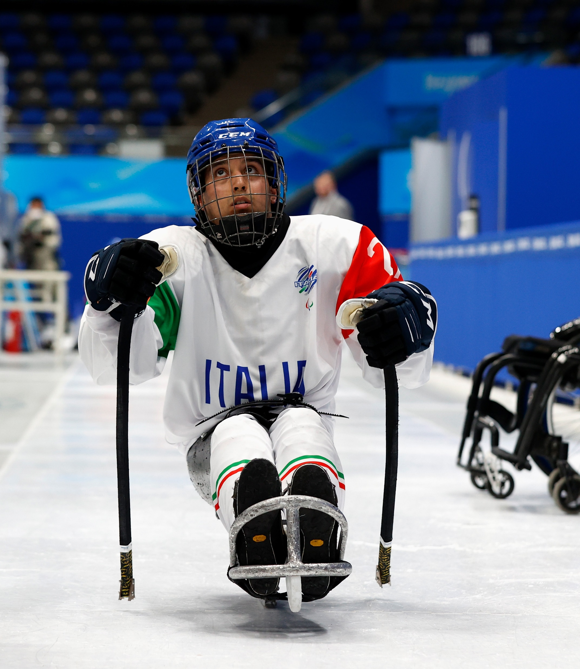
Who is in charge of the 2026 Winter Olympics?
Milano Cortina 2026 Organizing Committee (OCOG)
Plans and schedules Olympic events
Manages competition venues and athlete support
Coordinates transportation and logistics
Oversees ticketing and spectator services
Organizes opening and closing ceremonies
Ensures sustainability and legacy
Manages security, media, and broadcasting

Slide 4
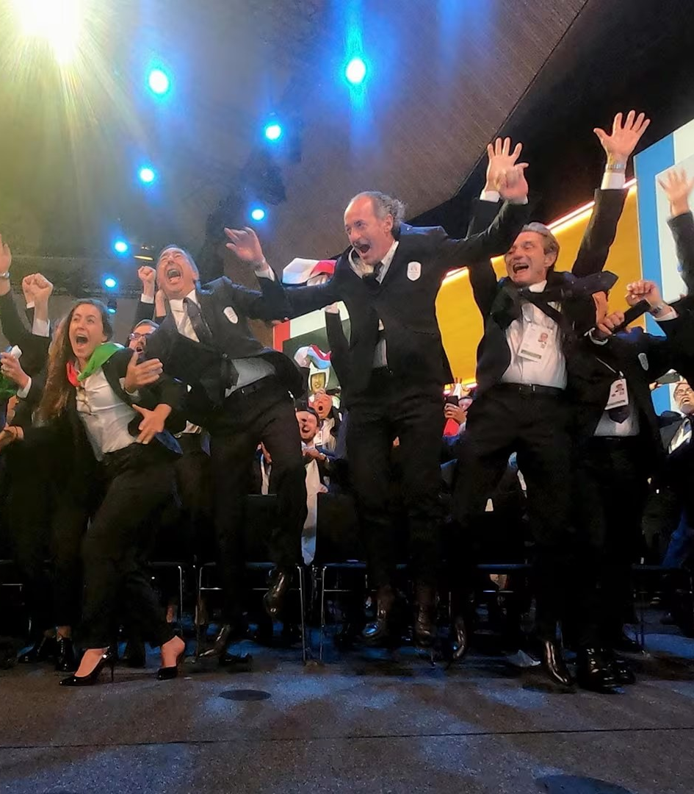
About the Milano Cortina 2026 Organizing Committee
Official body organizing the 2026 Winter Olympic & Paralympic Games in Italy
Formed after Milan and Cortina d'Ampezzo won the host bid
Collaborates with the IOC, CONI, and local governments
Aims to deliver a sustainable, inclusive, and memorable Games
Focused on innovation and creating a lasting legacy

Slide 5
Data Requirements in Milano Cortina 2026 Winter Olympics
Accommodation
Lodging Partners
Transportation
Transportation Routes
Accreditation
National Olympic Committees (NOCs)
Organizations
Athletes
Team Delegations
Participation
Sports
Sport Discipline
Event
Event Schedule
Medal Tally
Result
Media Personnel
Official Staff
Medical Services
Security Operations
Weather Conditions
Sponsors
Sales
Ticket
Venue
Venue Management
Volunteer Assignments
Volunteers

Slide 6
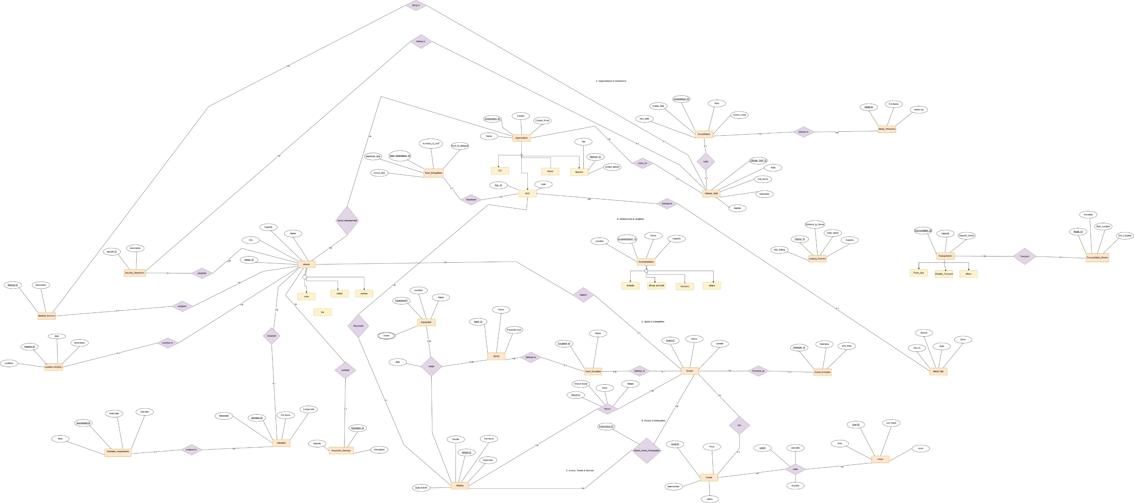
ERD Model

Slide 7

SQL queries DDL & DML

Slide 8

complex operations
Continues……

Slide 9


